Slide 1

Project on SPATIAL IMAGE CLUSTERING ANALYSIS
By
N. Pragna Patavi (08241A0582), Sambhavi. J(08241A0589),
Hema Latha(08241A05B7), Ramya Varanasi(08241A05B9)
Under the esteemed guidance of
Ch.Mallikarjuna rao
Associate Professor
Department of Computer Science and Engineering
GOKARAJU RANGARAJU INSTITUTE OF ENGINEERING AND TECHNOLOGY

Slide 2
SPATIAL DATA MINING
Spatial data mining is the process of discovering interesting and previously unknown, but potentially useful patterns from large spatial datasets. Extracting interesting and useful patterns from spatial datasets is more difficult than extracting the corresponding patterns from traditional numeric and categorical data due to the complexity of spatial data types, spatial relationships.
The neighbors of a spatial object may have an influence on it and therefore have to be considered as well.

Slide 3
Application domains of Spatial Data Mining
Describe/explain locations of human settlements in past few years
Find cancer clusters to locate hazardous environments
Prepare land-use maps from satellite imagery
Predict habitat suitable for endangered species
Find groups of co-located geographic features

Slide 4
CLUSTERING
Clustering is the classification of objects into different groups, or more precisely, the partitioning of a data set into subsets (clusters), so that the data in each subset (ideally) share some common trait. It is a technique used in data mining.
Clustering is a main task of explorative data mining, and a common technique for statistical data analysis used in many fields, including machine learning, pattern recognition, image analysis, information retrieval, and bioinformatics.

Slide 5
Density-based Algorithm like DBSCAN
locates regions of high density that are separated from one another by regions of low density.
Major features of density based clustering:
Discover clusters of arbitrary shape
Handle noise
One scan
Need density parameters as termination condition

Slide 6
DBSCAN
DBSCAN is a density-based algorithm.
(Density Based Spatial Clustering of Application with Noise)
It takes two parameters:
Eps: Maximum radius of the neighborhood
MinPts: Minimum number of points in an Eps- neighborhood of that point
Density = number of points within a specified radius (Eps)

Slide 7
Border & Core
Outlier
Border
Core
ε = 1unit
MinPts = 5

Slide 8
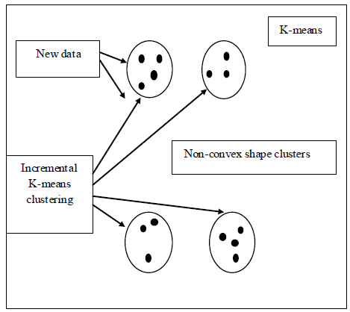
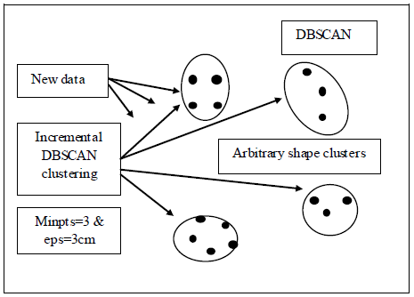
ADVANTAGES OF DBSCAN OVER K-MEANS
Cluster shapes

Slide 9
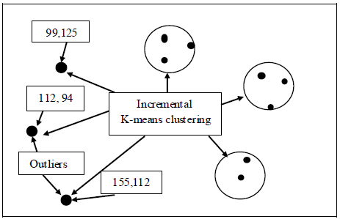
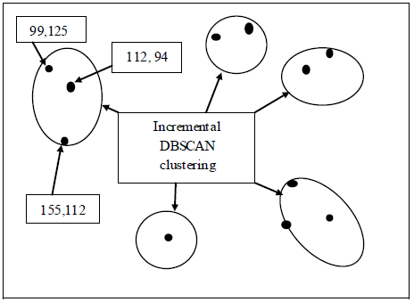
Predefined clusters numbers
Outliers handling

Slide 10
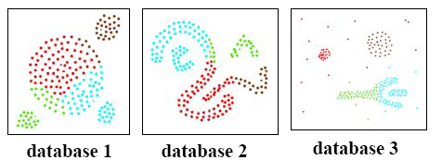
DBSCAN VS CLARANS
Clusters discovered by CLARANS
Clusters discovered by DBSCAN

Slide 11
DBSCAN is more effective in discovering clusters of arbitrary shape than CLARANS.
DBSCAN can identify noise whereas CLARANS cannot.
Runtime of CLARANS is comparatively very large.
CLARANS cannot be applied for large databases.
Results show that DBSCAN outperforms CLARANS by a factor of at least 100 in terms of efficiency.

Slide 12
IMPLEMENTATION
MATLAB (matrix laboratory) is a numerical computing environment. It allows matrix manipulations, plotting of functions and data, implementation of algorithms, creation of user interfaces, and interfacing with programs written in other languages, including C, C++, Java, and Fortran.
This project uses matlab , which takes satellite image as input from GUI and implements the DBSCAN algorithm on that image to give clusters.
By this, we can compare two images of the same region.

Slide 13
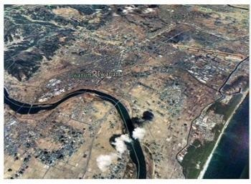
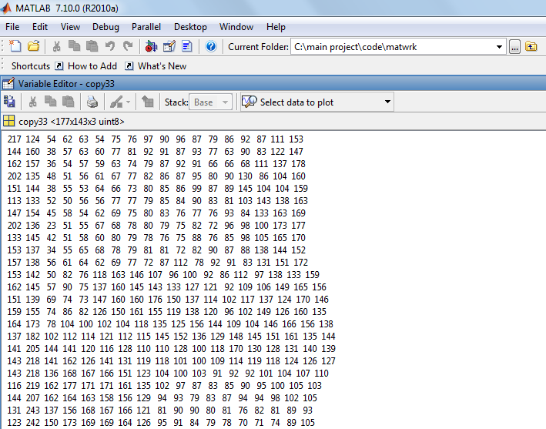
Here we take a spatial image and convert into a matrix using matlab
The DBSCAN algorithm is implemented on that matrix

Slide 14
DBSCAN Algorithm
select a point p
Retrieve all points density-reachable from p wrt ε and MinPts.
If p is a core point, a cluster is formed.
If p is a border point, no points are density-reachable from p and DBSCAN visits the next point of the database.
Continue the process until all of the points have been processed.

Slide 15
PSEUDOCODE
DBSCAN(D, eps, MinPts)
C = 0
for each unvisited point P in dataset D
mark P as visited
N = regionQuery(P, eps)
if sizeof(N) < MinPts
mark P as NOISE
else
C = next cluster
expandCluster(P, N, C, eps, MinPts)

Slide 16
expandCluster(P, N, C, eps, MinPts)
add P to cluster C
for each point P' in N
if P' is not visited
mark P' as visited
N' = regionQuery(P', eps)
if sizeof(N') >= MinPts
N = N joined with N'
if P' is not yet member of any cluster
add P' to cluster C

Slide 17
An Example
ε
C₁
C₁
MinPts = 4
ε
ε
C₁

Slide 18
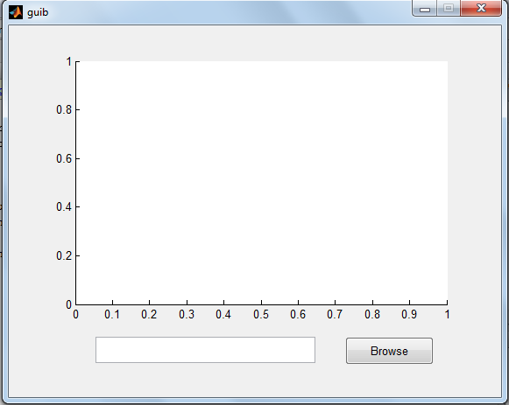
INTERFACE
The following is the GUI that takes an image as input

Slide 19
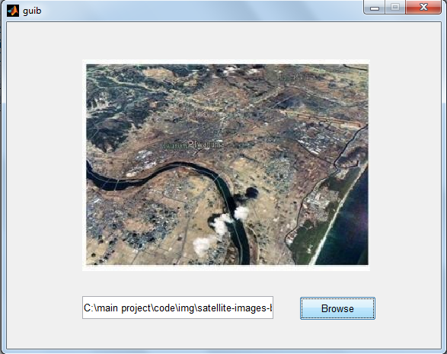
Spatial image

Slide 20
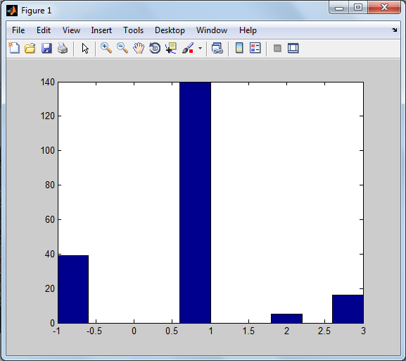
Image-1

Slide 21
The output is clustering of the image represented in the form of histograms.
X-axis gives the cluster number.
Y-axis gives the number of objects in each cluster.
-1 cluster in the x-axis represents the outlier points which is defined as a set of points in the database not belonging to any cluster

Slide 22
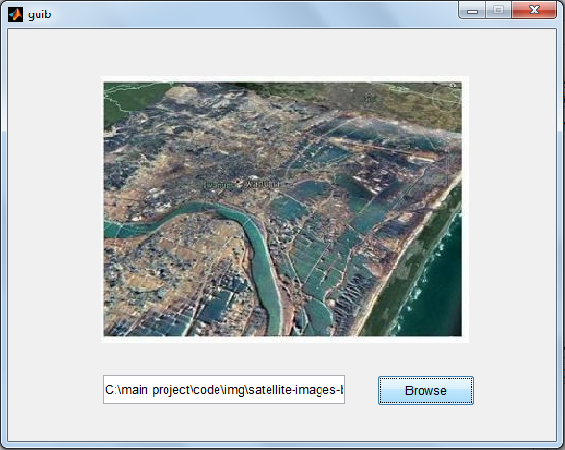
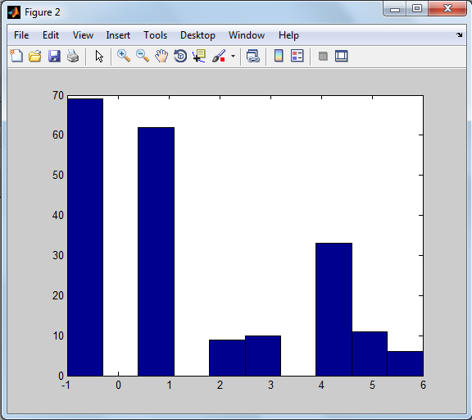
Image-2

Slide 23
Difference in the two images of the same region within a certain interval of time

Slide 24
THANK YOU!

